Slide 1
Tech Talk: Application Security IBM Application Security Services
Areej Essa Cloud Developer & Advocate IBM Hybrid Cloud
Content owner & creator: Areej Essa Areej.Essa@ae.ibm.com

Slide 2
- Application attacks incidents – who to blame? - Application security concerns and best practices - Security in Software Development Life Cycle - DevSecOps - Open source tools for secure code development
AGENDA

Slide 3

8%
8% increase - $96.3 billion extra spending by worldwide enterprises on application security in 2018 (Gartner)
Application Security Concerns
Source code – Mobile & Web applications
Vulnerable API’s
Cloud services
IoT connected to mobile devices
Open Source code
Data security

Slide 4

An application is the gateway to an organization’s data theft and attack executions on them.
On September 2017, Equifax was attacked:
145 million of its customer records were stolen
Over £42 million lost
Lost of its 100,000 customers
Caused due to a vulnerability in their web application

Slide 5
An application is the gateway to an organization’s data theft and attack executions on them.
69%
56%
48%
35%
Organizations do not perform any major testing methods prior to deployment
Organizations do not take basic security measures to remediate vulnerabilities
Organizations are influenced by pressure to release new apps quickly
Organizations did not know all the apps and databases currently active in their organizations

Slide 6


Who is involved?
Vendor or seller
Developer

Slide 7



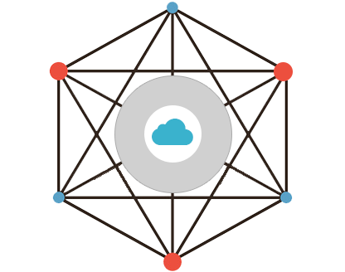



Lack of awareness
Lack of knowledge
Common excuses (OWASP):
“We never get hacked (that I know of), we don’t need security”
“We have a firewall that protects our applications”
"We trust our employees not to attack our applications”
Deadlines
Skill set
No enablement
Vendor or seller
Developer

Slide 8
Application Security Concerns
Source code – Mobile & Web applications
Vulnerable API’s
Cloud services
IoT connected to mobile devices
Open Source code
Data security

Slide 9
Reviews
Secure Coding Practices: Source Code Review
Bad code is the root cause of most web app breaches.
Cross-site Scripting
SQL Injections
Authentication of services
Code review run against set of rules to detect vulnerabilities in the code.
Performed at early stages of SDLC.
Performed by the developer along someone other than the developer.
Can be performed manually or automated using tools.
Dependen-cies
Logging
String exploits
URL design
Memory leaks

Slide 10
Reviews
Secure Coding Practices: Source Code Review
One of the most critical and commonplace security vulnerabilities for web applications.
Allow SQL commands to be executed on the web server to directly interrogate the back-end database.
Ability to return and steal tables of information, change records, or even delete the entire database.
SQL Injections
According to Gartner executive report, 2017:
Of total breaches reported in 2017, 32% were SQL injection errors.
SQL injection ranked as the most critical vulnerability, 92%, web application attack.
Notes:
here are various injection flaw types, but by far the most infamous is SQL injection, which has been successfully exploited by hackers for well more than a decade. SQL injection involves an attacker appending SQL database commands within an input field.

Slide 11
Reviews
Secure Coding Practices: Source Code Review
Use of a browser side script, to send malicious code to a different end user.
Occur anywhere a web application uses input from a user in the output it generates without validating or encoding it.
Cross-site Scripting
SQL Injections
According to Gartner executive report, 2017:
SQL injection ranked as the second most vulnerability, 38%, web application attack.

Slide 12
Reviews
Secure Coding Practices: Source Code Review
Cross-site Scripting
Authenticating of services (API’s) to the applications.
Code must include the authentication of the service before sending and receiving requests.
SQL Injections
Authentication of services

Slide 13
Reviews
Secure Coding Practices: Source Code Review
Logging of critical information such as:
Timestamp.
Identity of the account/user that caused the event.
Source IP address associated with the request.
Event outcome (success or failure).
Description of the event.
Cross-site Scripting
SQL Injections
Authentication of services
Logging

Slide 14
Reviews
Secure Coding Practices: Source Code Review
Cross-site Scripting
Ranked in one of the top 10 web application attacks by OWASP.
Application URL must not release sensitive information such as PII, API keys.
Can cause “forced browsing”.
Attackers can successfully gain sensitive data.
SQL Injections
Authentication of services
Logging
URL design
Notes:
Doing so presents a risk if the URL is cached in browser history, not to mention if it is recorded in logs on the server side. In addition, if the resource at the URL contains a link to an external site and the user clicks through, the sensitive data will be disclosed in the Referer header.
. Forced browsing (directory traversal) can be a very serious problem if an attacker tries to gather sensitive data through a web browser by requesting specific pages, or data files.
Using this technique, an attacker can bypass website security by accessing files directly instead of following links. This enables the attacker to access data source files directly instead of using the web application. The attacker can then guess the names of backup files that contain sensitive information, locate and read source code, or other information left on the server, and bypass the "order" of web pages.
Any device that exposes an HTTP-based interface is potentially vulnerable to Directory Traversal.
Prev
Secondly, define the list of file types available for remote reading on the server. And acl

Slide 15
Reviews
Secure Coding Practices: Source Code Review
Caused by memory buffer overflow.
Occurs when a developer dynamically allocates memory space for a variable, but fails to free up that space before the program completes (takes all the space and program becomes unresponsive).
Attacker submit data to an application larger than the allocated memory and overwrite valid data.
Cross-site Scripting
SQL Injections
Authentication of services
Logging
URL design
Memory leaks
Allocated memory
Memory

Slide 16

Reviews
Secure Coding Practices: Source Code Review
Attacker submit data to an application larger than the allocated memory and overwrite valid data.
New memory return address can allow the attacker to execute their malicious code.
Cross-site Scripting
SQL Injections
Authentication of services
Logging
URL design
Memory leaks
Allocated memory
Memory
Notes:
This extra data can overflow into adjacent memory, overwriting any valid data held in it, and often overwriting the return address that is used when the function ends. By writing a new return address, the hacker can trick the system into executing his or her own code.

Slide 17
Reviews
Secure Coding Practices: Source Code Review
Submitted data of an input string is evaluated as a command by the application.
Attacker can execute code, read the stack, or cause a segmentation fault in the running application.
Cross-site Scripting
SQL Injections
Authentication of services
Logging
String exploits
URL design
Memory leaks
Notes:
Attacker can execute code, read the stack, or cause a segmentation fault in the running application, causing new behaviors that could compromise the security or the stability of the system.

Slide 18
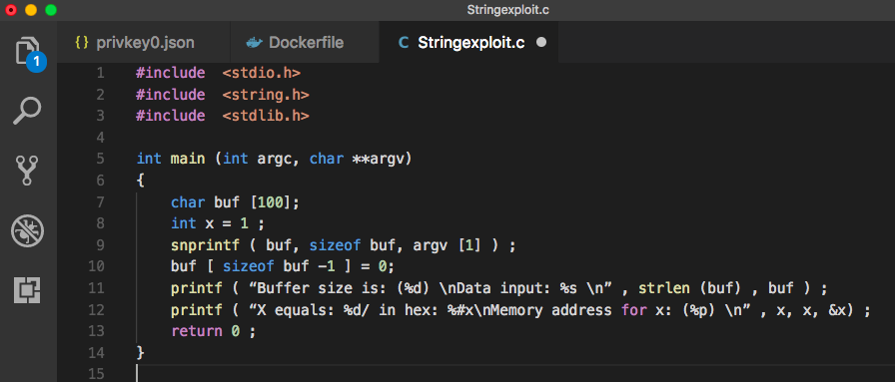
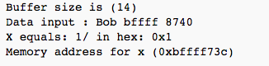
Reviews
Secure Coding Practices: Source Code Review
Illustration: Showing contents of a memory address
Cross-site Scripting
SQL Injections
Authentication of services
Logging
String exploits
URL design
Running:
./Stringexploit “myName %x %x” returns memory contents too.
Memory leaks
Source: https://www.owasp.org/index.php/Format_string_attack
Notes:
Attacker can execute code, read the stack, or cause a segmentation fault in the running application, causing new behaviors that could compromise the security or the stability of the system.

Slide 19
Reviews
Secure Coding Practices: Source Code Review
Third-party libraries highly used for faster development can introduce vulnerabilities to the code.
90% of software applications contain Third-party libraries. (Central Repository)
Might contain vulnerabilities. For example: GNU C Library contained a buffer overflow vulnerability.
Cross-site Scripting
SQL Injections
Authentication of services
Dependen-cies
Logging
String exploits
URL design
Memory leaks

Slide 20
Application Security Concerns
Source code – Mobile & Web applications
Vulnerable API’s
Cloud services
IoT connected to mobile devices
Open Source code
Data security

Slide 21

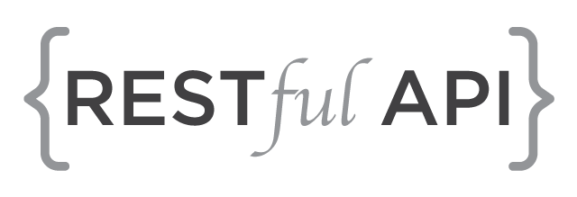
Cloud Services API’s
Developer/Application
Cloud services provider
Insecure cloud API’s can pose a variety of risks related to confidentiality, integrity, availability and accountability.

Slide 22
Application Security Concerns
Source code – Mobile & Web applications
Vulnerable API’s
Cloud services
IoT connected to mobile devices
Open Source code
Data security

Slide 23

Vulnerable Open Source Codes
Accelerated development using open source
Open source codes can contain vulnerabilities
Use of un-scanned third-part libraries and tools
Developers fail, forget or even dismiss the update of the latest version of the used libraries
57% of enterprises deploy open-source in their production environment
50% of enterprises have no formal approval process for open-source code
53.8% increase in the number of open source application library security in 2016
Examples of successful attacks (2016):
Nokogiri and LobXML were attacked by DoS and private data disclosure.

Slide 24
Application Security Concerns
Source code – Mobile & Web applications
Vulnerable API’s
Cloud services
IoT connected to mobile devices
Open Source code
Data security

Slide 25




Data Security
Every 2 years, enterprise will double its data
Over the past 25 years, enterprises spent trillions on digitizing analogue data
Major focus is on productivity, overlooking their data security
The percentage of data breaches from a web application attack was 7% in 2015 and grew to 40% in 2016.
(Gartner)

Slide 26
Does an organization need to treat all of its the data in the same way?
Not all the data need to be treated in the same way
Critical and sensitive data needs to be more protected than ordinary data
Saves cost and time, and effectively protects sensitive data

Slide 27





Software Development Lifecycle - Issues
Retrospective Fixes
Cost to Fix at Production
Lack of Security Requirements
Inconsistent Development Standards
Lack of Security by Design
Maintain
Design
Application Development Lifecycle
Time to Market vs. Security
Accept or Remediate
Platform Vulnerabilities
Deploy
Legacy Software Libraries
Insecure Protocols
Insecure Configuration
Poor Development Practices
Develop
Build/Test
Limited Security Testing Scope
Large Numbers of False Positives
Tool or Vendor Limitations
Prioritization of Fixes
Copyright IBM Corporation 2018
Notes:
This slide outlines typical challenges organizations face when trying to layer security over an existing SDLC process

Slide 28
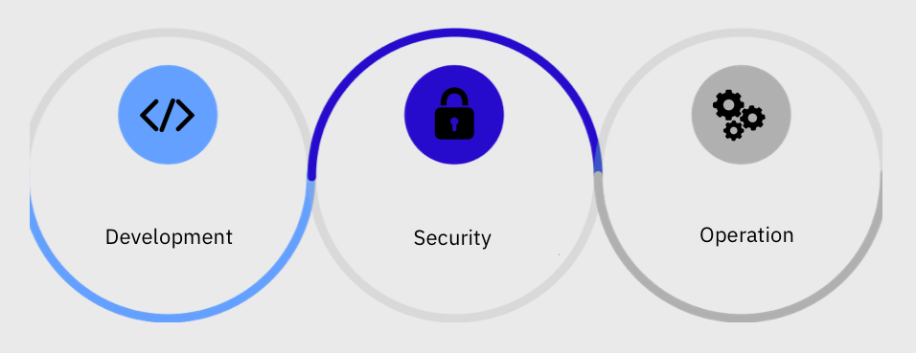
DevSecOps

Slide 29
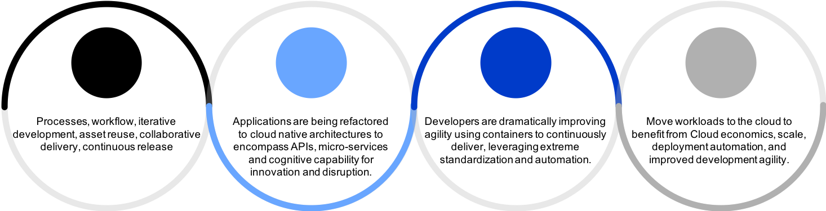
Dev
Sec
Ops
Development
Security
Operation
Automate core security tasks by embedding security controls and processes into the DevOps workflow.

Slide 30
What is DevSecOps?
Adds the element of Security to DevOps
Embed concepts of Security in every step of SDLC
Everyone is responsible for Security
Use tools to automate various Security processes such as:
Code Review
Identity and Access Management
Vulnerability Scanning

Slide 31
Benefits of DevSecOps
Cost Reduction
Detect & fix Security issues during development phase
Speed of Delivery/Recovery
Eliminate Security bottlenecks
Secure by design
Automated code review, vulnerability scanning
Secure iterative innovation
Innovate securely at speed & scale

Slide 32
Common Practices of DevSecOps
Risk Assessment
Threat identification
Strategies
Secure Coding
High Cohesion & Loose Coupling
SAST – Static Application Security Testing
Code Analysis
Secure Infrastructure (Cloud?)
Server updates
Backups

Slide 33
Five Principles in DevSecOps
Key values of DevSecOps
Greater speed and agility for security teams
An ability to respond to change and needs rapidly
Integrating security into the CI/CD pipeline ensures that security testing happens with every release
More opportunities for automated builds and quality assurance testing
Early identification of vulnerabilities in code
Reduces costs and achieves agility
1. Automate security in
2. Integrate to “fail quickly”
3. No false Alarms
4. Build security champions
5. Keep operational visibility
Source: FIVE PRINCIPLES FOR Securing DevOps, VERACODE eBook

Slide 34

Five Principles in DevSecOps
Key values of DevSecOps
Greater speed and agility for security teams
An ability to respond to change and needs rapidly
Integrating security into the CI/CD pipeline ensures that security testing happens with every release
More opportunities for automated builds and quality assurance testing
Early identification of vulnerabilities in code
Reduces costs and achieves agility
1. Automate security in
Open Source Tools for Secure Code Development
2. Integrate to “fail quickly”
3. No false Alarms
4. Build security champions
5. Keep operational visibility
Source: FIVE PRINCIPLES FOR Securing DevOps, VERACODE eBook

Slide 35
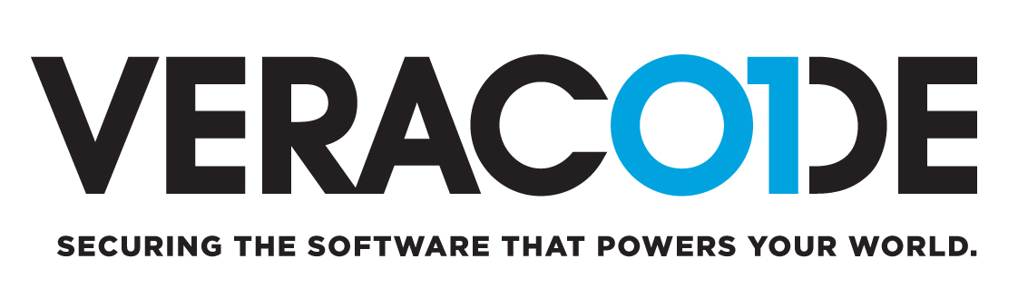


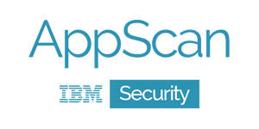
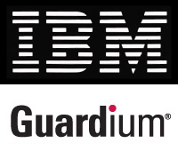

Open Source Tools for Secure Code Development
Veracode: Static analysis tool
Grafeas (IBM & Google): Maintain proper security standards for software
Black Duck: (IBM Security Partner): Automate the processes of securing and managing open source
Open source Analyzer: Scans open source code
OWASP Code crawler: Static code review tool
IBM AppScan: Source code review
IBM Guardiam: Data Security
Notes:
prevents leaks from databases, data warehouses and Big Data environments such as Hadoop, ensures the integrity of information and automates compliance controls across heterogeneous environments.

Slide 36
Code Lab: Test our application using IBM Application Security on Cloud
Five Principles in DevSecOps
Key values of DevSecOps
Greater speed and agility for security teams
An ability to respond to change and needs rapidly
Integrating security into the CI/CD pipeline ensures that security testing happens with every release
More opportunities for automated builds and quality assurance testing
Early identification of vulnerabilities in code
Reduces costs and achieves agility
1. Automate security in
2. Integrate to “fail quickly”
Let’s scan an application
Create an IBM Cloud Account: ibm.biz/devfest
Go to IBM Application Security on Cloud: https://appscan.ibmcloud.com/AsoCUI/serviceui/home
3. No false Alarms
4. Build security champions
5. Keep operational visibility
Source: FIVE PRINCIPLES FOR Securing DevOps, VERACODE eBook

